Slide 1
FHIR for Clinicians and Decision Makers
HL7 Working Group Meeting
Madrid May, 2017
Dr. David Hay

Slide 2

This presentation
Can be downloaded here:
http://gforge.hl7.org/svn/fhir/trunk/presentations/2017-05%20Tutorials/FHIR%20for%20clinicians.pptx
Use “anonymous” and email address to logon
Is licensed for use under the Creative Commons, specifically:
Creative Commons Attribution 3.0 Unported License
(Do with it as you wish, so long as you give credit)

Slide 3
FHIR | Todays Agenda
Why FHIR?
Benefits
The basics: resources and references
ClinFHIR
Exercise: build scenario
Structured and Coded Data
Profiling
Paradigms of Exchange
Ecosystem

Slide 4
Who am I?
Name: David Hay
Company: Orion Health
Background:
Medical Doctor
Chair Emeritus of HL7 New Zealand
Co-chair FHIR Management Group
Blog: fhirblog.com
Tooling: clinFHIR.com

Slide 5
Who are you?
What’s your background with HL7?
v2? v3? CDA? Brand new?
What’s your role?
Decision Maker? Manager? Clinician? Other?
What’s the single most important thing for you to get out of today’s course?
Please be brief!

Slide 6
Tutorial objectives:
You understand the drivers for FHIR, and the benefits
You can describe it to others
You know where to find out more information
You are familiar with clinFHIR
You can engage with the community

Slide 7
Why Interoperability
Health information sharing is becoming increasingly important
Individuals involved in delivering care to consumers now expect the information they require to be available at the point of care
Data collected in multiple places
Realistically need to move information around
Interfaces are expensive
Especially if not standards based

Slide 8
Why FHIR?
HL7 defines Interoperability Standards
In 2011, the Board of HL7 noted:
Interoperability requirements are increasing
Need for real time access (API) – Mobile
Vast increase in the amount, type and source of data
e.g. Devices, Genomics
Analytics, population health
Implementer expectations
Existing standards were lacking, a fresh look was needed…

Slide 9
Benefits of fhir

Slide 10
Benefits to Implementers and Vendors
Familiar tooling and technologies
XML/JSON, HTTP, REST, SSL, OAuth
Predefined resources and APIs
With built in extensibility
Allows implementer to focus on the core application functionality
Extensive documentation, samples and reference server implementations
Validation services
Active and supportive community
Open Source code libraries
HAPI (Java) and Furore (.Net)
Mobile friendly
Increases commercial viability of app development as FHIR compliant apps will work with different FHIR Servers (EMRs, HIEs)

Slide 11
Benefits to Clinicians
Clinicians can get involved in system design
Tooling available
Improved access to more complete, higher quality patient information incl. genomics
Greater choice and variety of applications and devices to support clinical workflow
Increased IT development speed – solving business problems faster in innovative ways
Improving Decision Support
E.g. Immunization protocol
Saving time

Slide 12
Benefits to Consumers
Prospect of improved patient engagement apps, enabled through FHIR APIs to clinical systems
Can engage more deeply
Clinician has access to a more complete patient record and improved decision making tools, leading to:
Better decision making
More efficient diagnosis and treatment
Higher quality care
Overall improved patient experience – reducing wasted time

Slide 13
Benefits to Health Care Organisations
Most vendors are committed to FHIR
Should lead to:
faster deployments
lower cost interoperability
reduced vendor lock in as FHIR is adopted by source systems
Standards based APIs to support internal application development
Capture data for
Analytics and Decision Support
Population Management

Slide 14
Basics of fhir

Slide 15
The goals of FHIR (FHIR manifesto)
Implementer Focus
Target the 80% (common stuff)
Use today’s web technologies
Spec & artifacts
Support human readability
Paradigm & architecturally agnostic
Open Source

Slide 16
Overview of FHIR
Fast Healthcare Interoperability Resources (FHIR)
Consistent, simple to use content model (resources)
Controlled extensibility
Supports all paradigms of exchange
Real-time APIs
Documents, Messages & Operations
Designed with implementers in mind
Freely available
Detailed on-line, hyperlinked specification
Freely available tooling, servers, libraries
Strong endorsement and support from vendors, providers and regulatory community (e.g. NHS, INTEROpen, Project Argonaut)
Massive supporting community

Slide 17
Related to other healthcare Standards
HL7
Version 2
Version 3
CDA
openEHR
CIMI
IHE
DICOM
Terminologies
SNOMED
ICD

Slide 18
Timeline: Where does FHIR fit?
V2
1987
Start V3
1995
V3
CDA
2005
Fresh
Look
2011
FHIR
STU 3
2016
FHIR
CDA
V3
V2
1980
1990
2000
2010
2020
Notes:
STU3 in march 2017

Slide 19
Where can you use FHIR
v3
Application
v2
FHIR
PHR
FHIR
Broker
Comm.
Interface
FHIR
DB
Notes:
Brian to talk more

Slide 20
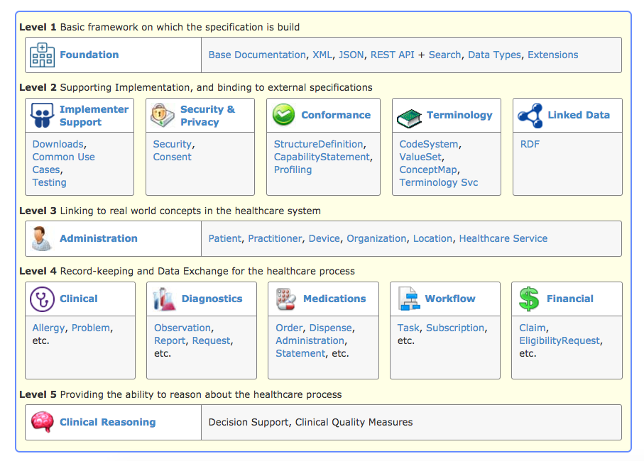
The specification
http://hl7.org/fhir/index.html
Notes:
Show modules
Go through menu at top
Brief look at resources

Slide 21
Resources: What are they?
The Content model
The Thing that is exchanged
Via REST ( FHIR Restful API), Messages, Documents
Informed by much past work inside & outside of HL7
HL7: version 2, version 3 (RIM), CDA
Other SDO: openEHR, CIMI, ISO 13606, IHE, DICOM
Notes:
vs FHIR REST paradigm - treat data as independently , retrievable resource using http - think of browsing on the web
FHIR RESTful API endpoints on a server and the stuff you can do to get them back
3) FHIR documents/ document paradigm = type of bundle vs CDA Document architecture using FHIR - Clinical document practice - profile on FHIR for CDA on top of that a ccda profile that expresses the dataelements in

Slide 22




Resources
General:
AllergyIntolerance
Condition (Problem)
Procedure
ClinicalImpression
FamilyMemberHistory
RiskAssessment
DetectedIssue
Care Provision:
CarePlan
CareTeam
Goal
ReferralRequest
ProcedureRequest
NutritionOrder
VisionPrescription
Medication & Immunisation:
Medication
MedicationOrder
MedicationAdministration
MedicationDispense
MedicationStatement
Immunization
ImmunizationRecommendation
Diagnostics:
Observation
DiagnosticReport
DiagnosticOrder
Specimen
BodySite
ImagingStudy
ImagingObjectSelection
Maturity Model
Notes:
Maturity model
Goto the spec – resource list

Slide 23
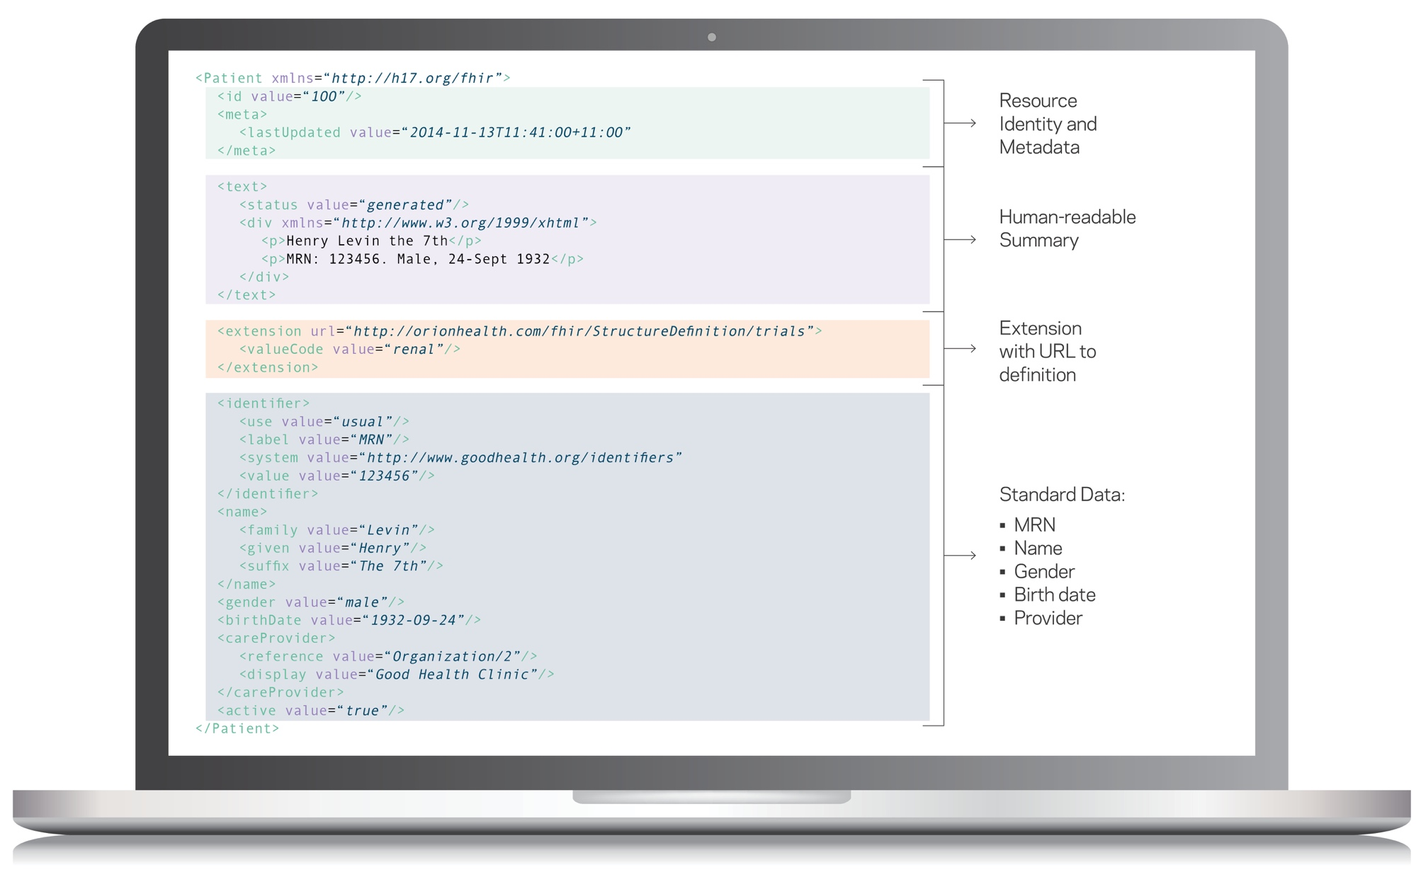
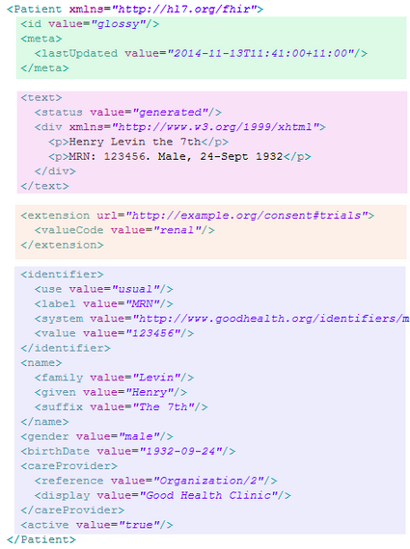
FHIR the basics | Resource example
Resource Identity & Metadata
Human Readable Summary
Extension with URL to definition
Standard Data:
MRN
Name
Gender
Birth Date
Provider
XML and JSON

Slide 24
FHIR the basics | References between resources
Coded Properties
type
bodySuite
indication
performer.role
complication
relatedItem.type
Other Properties
identifier (Identifier)
outcome (String)
PATIENT
Subject
CONDITION
Related Item
PROCEDURE
Report
DIAGNOSTIC REPORT
Encounter
Performer
ENCOUNTER
PRACTITIONER

Slide 25
FHIR the basics | Recording a consultation
12-year-old-boy
First consultation
Complaining of pain in the right ear for 3 days with an elevated temperature. On examination, temperature 38°C and an inflamed right eardrum with no perforation. Diagnosis Otitis Media, and prescribed Amoxicillin 250mg 3 times per day for 7 days.
Follow up consultation
2 days later returned with an itchy skin rash. No breathing difficulties. On examination, urticarial rash on both arms. No evidence meningitis. Diagnosis of penicillin allergy. Antibiotics changes to Erythromycin 250mg 4 times per day for 10 days.
Patient
Encounter
Condition
Observation
Medication
Allergy Intolerance

Slide 26
As linked resources…
Pain right ear 3 days
Asserter
Patient
Encounter
Elevated temperature
Performer
Temperature 38°C
Performer
Practitioner
Inflamed right drum
Performer
Otitis media
Asserter
Amoxicillin 250mg
Prescriber
Itchy skin rash
Asserter
Encounter
No breathing difficulties
Asserter
Urticarial Rash
Performer
Penicillin Allergy
Performer
Erythromycin 250mg
Performer

Slide 27
clinfhir

Slide 28
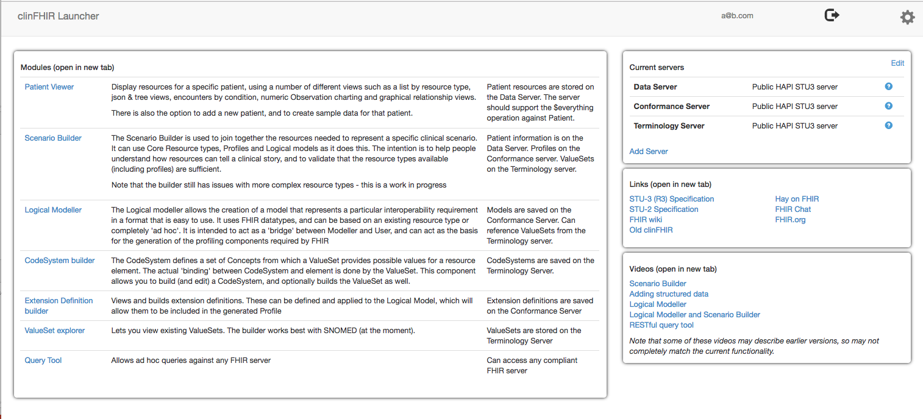
clinFHIR
Developed as training tool
Evolving!
Main components
View Patient data
Scenario Builder
Logical Modeler
ValueSet explorer
Extension Definition editor
Clinfhir.com

Slide 29
clinFHIR: Server roles
Specific server roles
Data/patient – patient related (clinical) and ‘reference’ (Practitioner, Organization)
Conformance – profile, extensionDefinition (both StructureDefinition)
Terminology – ValueSet & Terminology operations
Important to be STU consistent!
We’ll use Hapi3
Patient and Data
Profiles
(Conformance)
Terminology
clinFHIR

Slide 30
Demo
Describe each module, & what it is for
Details for:
View data for a patient
Scenario Builder

Slide 31
Exercise 1
View data for a patient
Hints
Select HAPI3 server
If you can’t find a patient with data, then create one

Slide 32
Exercise 2
Use scenario builder to build resource graph
Option 1 (Straight forward)
Problem list
Add Patient, List, Condition
Hook up List to Condition
Option 2 (Complex)
Consultation from example
Hints
Don’t worry about structured data (yet)
Create the patient first
Have each consultation as a separate scenario – may want just one

Slide 33
break

Slide 34
Review
How did you go?

Slide 35
Structured and coded data

Slide 36
Why have structured / coded data
Structured vs Coded
Coded:
Improves UI possibilities
Improves exchange
‘Secondary’ uses
Decision Support
Precision Medicine
Population health

Slide 37
FHIR the basics | Resource example
Resource Identity & Metadata
Human Readable Summary
Extension with URL to definition
Standard Data:
MRN
Name
Gender
Birth Date
Provider
XML and JSON

Slide 38
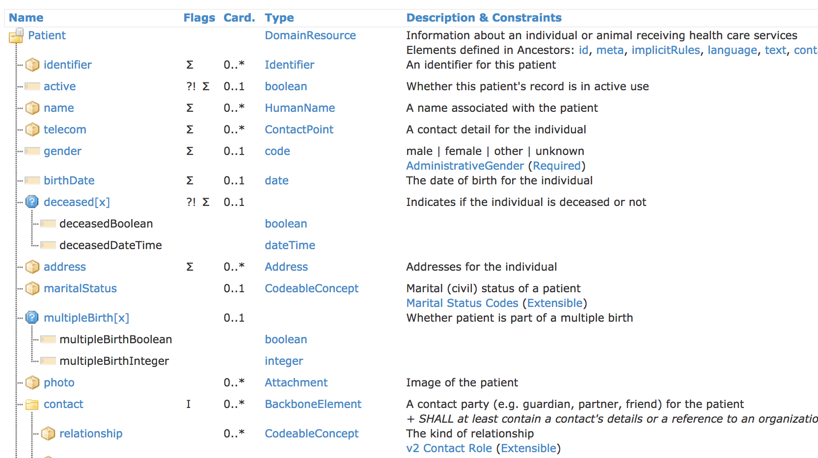
Resource structure
Notes:
Each Resource is composed of about 20-40 resource “elements”
Each resource element is defined by:
Name
Cardinality
Type (Data type or structural resource)
Description
Terminology Binding
Other stuff (Comments, Constraints, Summary Flags, mappings, etc)

Slide 39
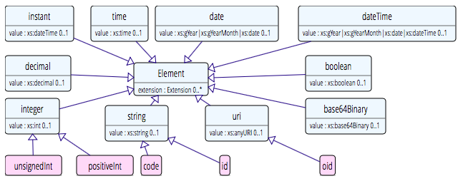
Data types: Primitive
Based on w3c schema and ISO data types
Stick to the “80% rule” – only expose what most will use
Simplified

Slide 40
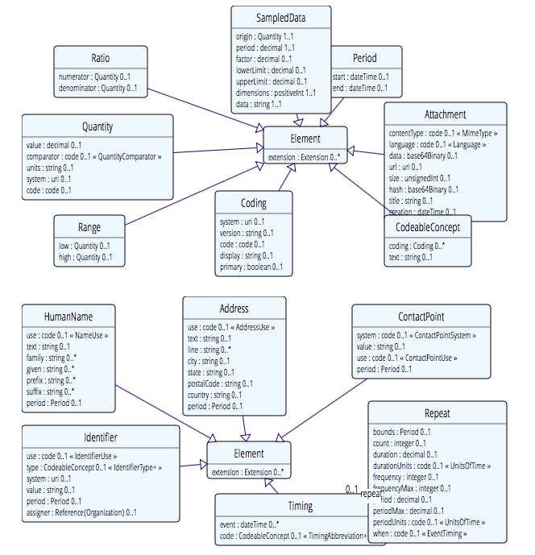
Data types: Complex
Notes:
Complex meaning composed of other datatypes - example identifer, codeableConcept

Slide 41
Datatypes
Review datatypes in spec
Start from resource
Datatypes in resource definition
Backbone element
‘choice’ data types
Identifiers
Review coded data
ValueSet binding

Slide 42
Coded datatypes
Code: "status" : "confirmed"
Coding: { "system": "http://www.nlm.nih.gov/research/umls/rxnorm", "code": "C3214954", "display": "cashew nut allergenic extract Injectable" }
CodeableConcept: { "coding": [{ "system": "http://snomed.info/sct", "code": "39579001", "display": "Anaphylactic reaction“ }], "text" : "Anaphylaxis" }

Slide 43
Terminology Sub-system
Code System:
Defines a set of concepts with a coherent meaning Code Display
Definition
SNOMED CT / LOINC / RxNORM
ICPC, MIMS + 100s more
ICD-X+
A drug formulary
Custom

Slide 44
Terminology Sub-system
Code System:
Defines a set of concepts with a coherent meaning Code Display
Definition
Value Set:
A selection of a set of codes for use in a particular context
Selects
Notes:
Eg condition with different specialties

Slide 45
Terminology Sub-system
Code System:
Defines a set of concepts with a coherent meaning Code Display
Definition
Value Set:
A selection of a set of codes for use in a particular context
Element Definition: Type and Value set reference
Binds
Selects

Slide 46
Terminology Sub-system
Code System:
Defines a set of concepts with a coherent meaning Code Display
Definition
Value Set:
A selection of a set of codes for use in a particular context
Element Definition: Type and Value set reference
Binds
Selects
Conforms
Refers to
Element: code/ Coding/ CodeableConcept

Slide 47
ValueSet
{
"resourceType": "ValueSet",
"id": "condition-code",
"url": "http://hl7.org/fhir/ValueSet/condition-code",
"compose": {
"include": [
{
"system": "http://snomed.info/sct",
"filter": [
{
"property": "concept",
"op": "is-a",
"value": "404684003"
}
]
},
{
"system": "http://snomed.info/sct",
"concept": [
{
"code": "160245001",
"display": "No current problems or disability"
}
]
}
]
}
}
A context specific subset of one or more Code Systems
Promotes consistency between applications
Key component of Terminology
Also CodeSystem
Target of a number of services
$expand

Slide 48
Exercise
Add coded data to scenario already built
Eg MedicationStatement.code
Condition.code

Slide 49
Adapting FHIR to your needs: Profiling
Many different contexts in healthcare, but want a single set of Resources
Need to be able to describe ‘usage of FHIR’ based on context
Allow for these usage statements to:
Authored in a structured manner
Published in a registry & Discoverable
Used as the basis for validation, code, report and UI generation.
3 main aspects:
Constraining a resource - remove element, change multiplicity fix values
Change coded element binding
Adding a new element (an extension)
Profiling adapts FHIR for specific scenarios

Slide 50
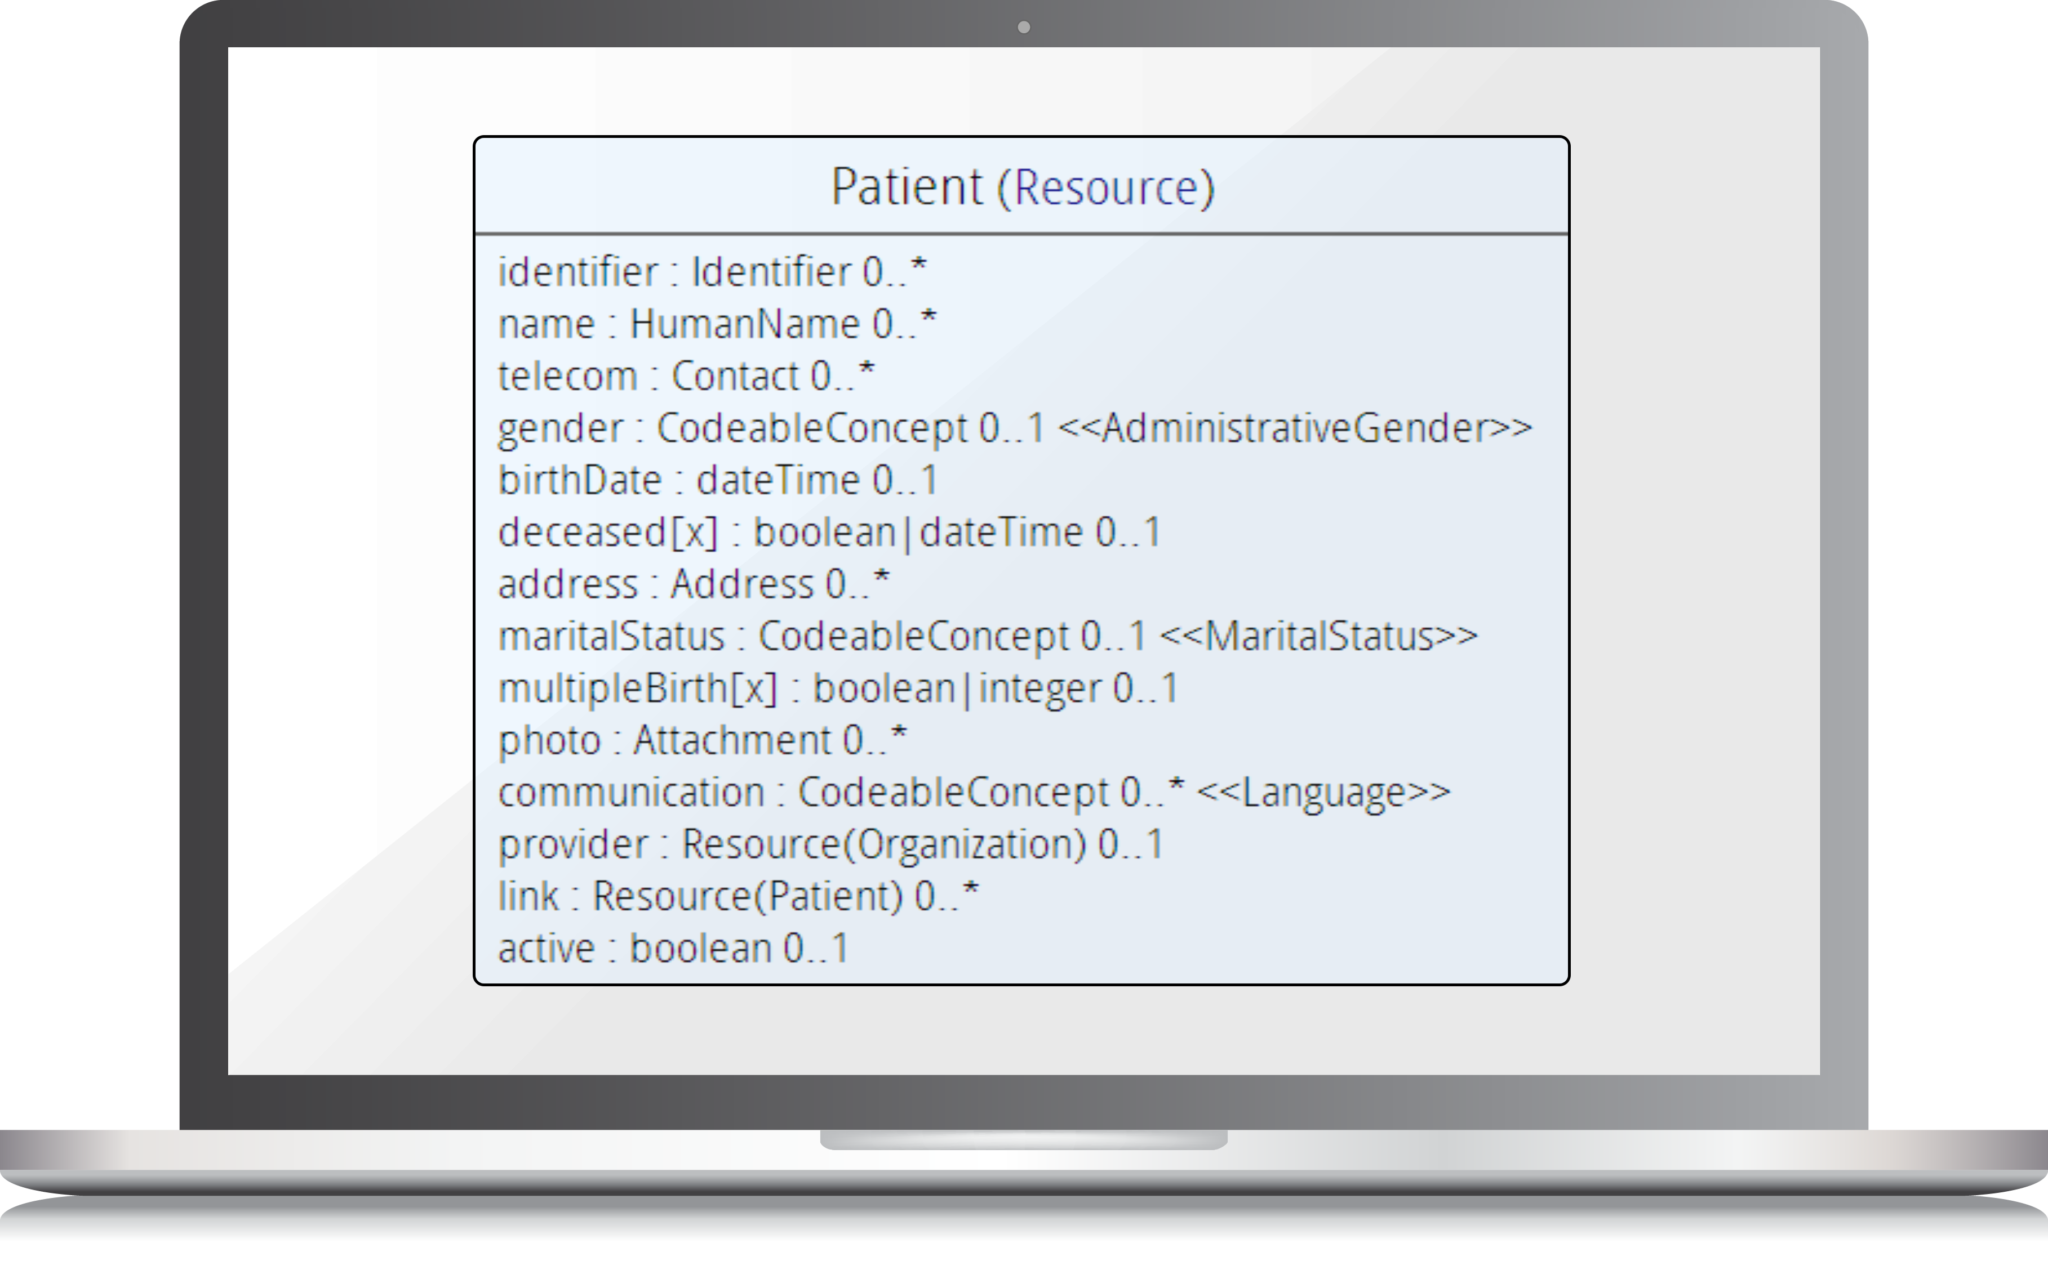
For example…
Require that the identifier uses the NHS number – and is required
Limit names to just 1 (instead of 0..*)
Change maritalStatus to another set of codes that extends the one from HL7 international
Don’t support photo
Add an extension to support ethnicity
Note: Limited mandatory elements in the core spec

Slide 51
The ‘profile’
Defined by StructureDefinition resource
Same as used for core resources
Defines each element
Path, name, dataType, binding, multiplicity. mapping & much more
Including allowable extension points
Can use Forge tooling to build
clinFHIR (and others) for learning/viewing
US Core (was DAF)
http://hl7.org/fhir/us/core/index.html

Slide 52
Extension Definitions
Also a StructureDefinition
Defines the content of a single extension
Simple or Complex
Definition:
Available on the web
Canonical Url
Resolvable or Registry
In resource instance:
Reference to Url
Extension or ModifierExtension

Slide 53
clinFHIR: Profiling support
Extension Definition
Create/edit
Logical Modeller
Purpose/s
Generating a ‘real’ profile
Demo

Slide 54
Exercise 3 (If time)
Create a profile
Steps
Create an extension Definition
Moon phase, string
Create a model based on condition
Remove unwanted elements
Add extension
Generate profile
View in Scenario Builder
Logical Model and Profile

Slide 55
Exchange Paradigms
REST
Documents
Messages
Services
(Operations)

Slide 56
Bundles
Container resource
Types of Bundle
Searchset
Transaction
Batch
Document
Message
Bundle Resource
Observation Resource
Device Resource
List Resource
Condition Resource

Slide 57
REST (API)
“Representational State Transfer” – an architecture for how to connect systems in real time
Uses HTTP/S
Simple to use
Very commonly used outside of healthcare – especially mobile
For simple interactions
Create
Read (& Query)
Update
Delete
A lot of tooling / experience available

Slide 58
Document paradigm
Summary at a point in time
Part of record
Very common
CDA
CDA on FHIR

Slide 59
Documents – are bundles
Composition Resource
<Bundle>
<entry>
<Composition />
</entry>
<entry>
<Observation />
</entry>
<entry>
<Device />
</entry>
<entry>
<List/>
</entry>
<entry>
<Condition/>
</entry>
</Bundle>
Metadata
Attester
Section
Section
Section
Observation Resource
Device Resource
List Resource
Condition Resource
Notes:
A Document, no matter how nested, is flattened to a list of entries, the Document’s header being the first.
The document header (and any other the other resources) refer to each other using normal references to reflect the document’s nesting.
Of course, there may be a digital signature (on the whole Bundle) to attest to the content of the document.

Slide 60
Messaging paradigm
Notification or instruction
Not part of record
HL7 v2
Good match with FHIR
Though implementations less common
Work in progress

Slide 61
Messages – are bundles
MessageHeader Resource
<Bundle>
<entry>
<MessageHeader />
</entry>
<entry>
<Observation />
</entry>
<entry>
<Patient />
</entry>
<entry>
<Device />
</entry>
</Bundle>
source
destination
event
Observation Resource
Device Resource
Patient Resource
Notes:
A Message is similar, refers (amongst others) to its author, and contains information about the source, destination and the event that triggered it.
A message contains 1 “data” resource, which is the root of the payload of the message. This is just a normal resource, which in its turn can refer to other related resources.

Slide 62
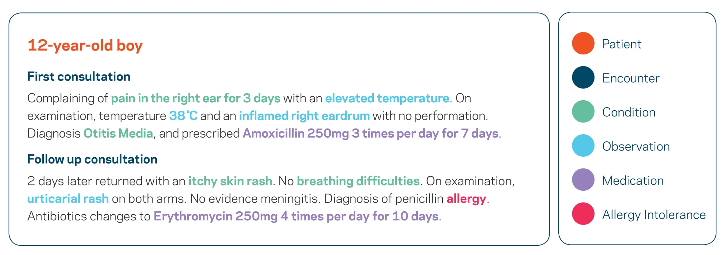
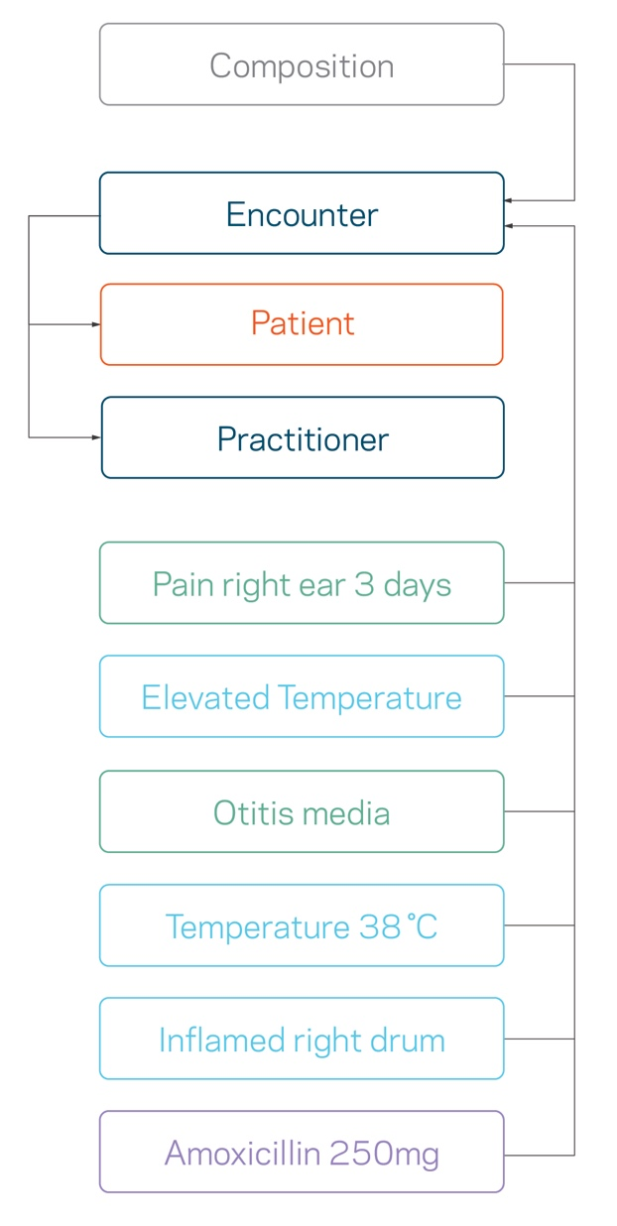
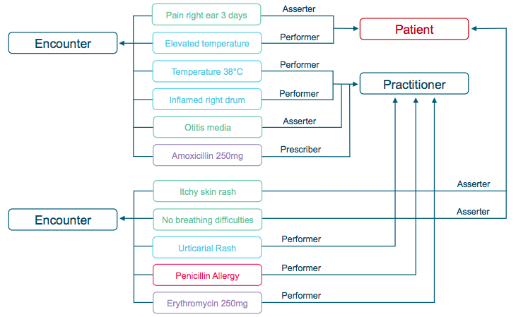
Documents and Messages

Slide 63
Services / Operations
For more complex server side logic
Can be Real-time
Key part of ecosystem
E.g.
Prescribing with Decision Support
Terminology
Immunization protocols

Slide 64
FHIR Operations
When more complex server logic required than simple CRUD
Midway between REST & SOAP
Some defined in spec. e.g.:
Get all data for a patient
Expand/filter terminology
CDS services
Can define custom services
Still using FHIR resources
Resources to define / inputs

Slide 65




Regardless of paradigm, the content is the same
Message
Rest
FHIR
Repository

Slide 66
The ecosystem

Slide 67
An ecosystem
A digital ecosystem is a distributed, adaptive, open socio-technical system with properties of self-organisation, scalability and sustainability inspired from natural ecosystems.
Wikipedia

Slide 68
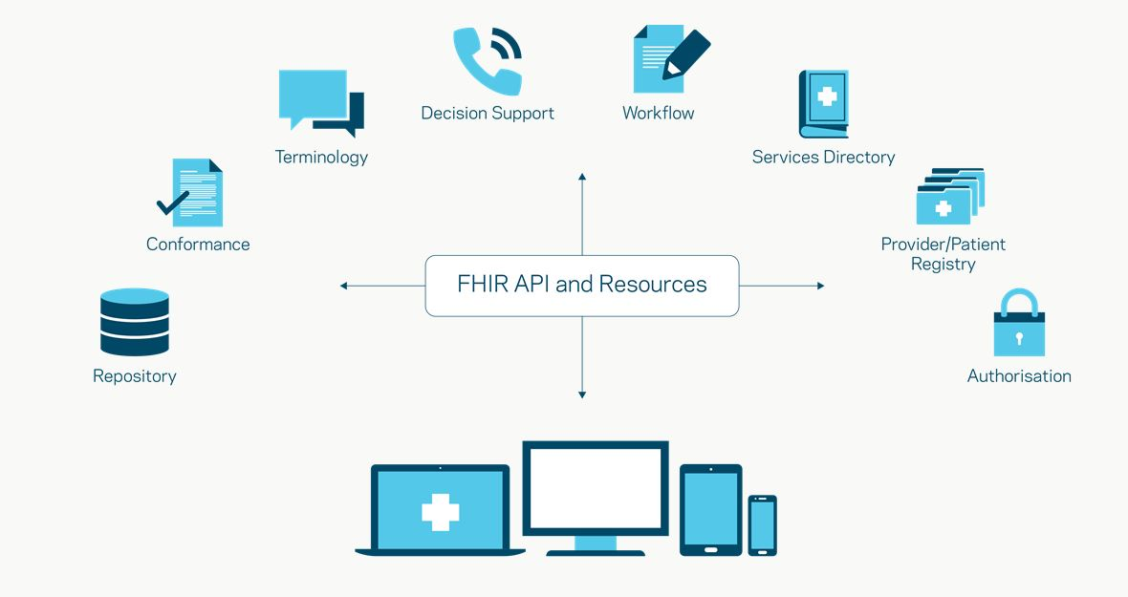
Components

Slide 69




Security
FHIR is not a security standard
Leverages existing standards – for example
TLS
OAuth2
Support in the specification
Security tags (metadata)
Specialized resources
Provenance
AuditEvent
More detail
http://hl7.org/fhir/security.html

Slide 70
Supporting Standards
SMART
CDS-hooks

Slide 71
More information
From HL7
http://hl7.org/fhir/index.html
wiki.hl7.org/index.php?title=FHIR
http://www.fhir.org/
Community
https://chat.fhir.org/
List server (fhir@lists.hl7.org )
Stack Overflow (tag FHIR)
Blogs
www.healthintersections.com.au/
https://fhirblog.com/
https://thefhirplace.com/
https://brianpos.com
Libraries
Java (http://hapifhir.io/)
C# (NuGet HL7.FHIR)
Tooling
Forge (http://fhir.furore.com/Forge)
http://clinfhir.com/
Test servers
http://wiki.hl7.org/index.php?title=Publicly_Available_FHIR_Servers_for_testing
https://fhirblog.com/2016/10/19/setting-up-your-own-fhir-server-for-profiling/

Slide 72

Questions?

